Slide 1
Linear Regression Model Using Matrices Multiple Regression and Correlation Nonlinear Regression Models

Slide 2
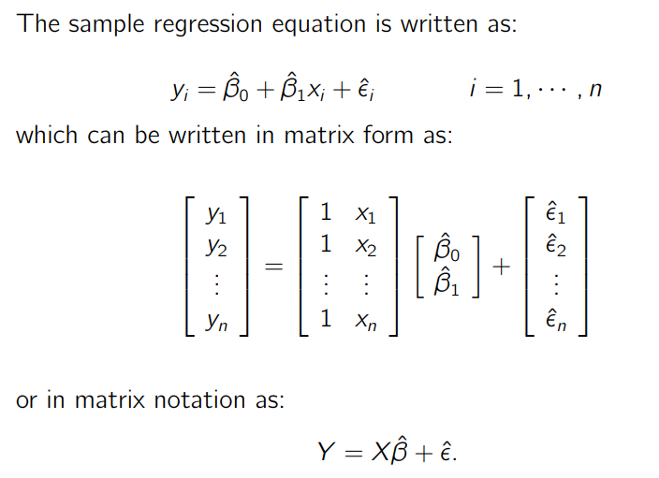
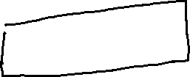
Linear Regression Model Using Matrices

Slide 3
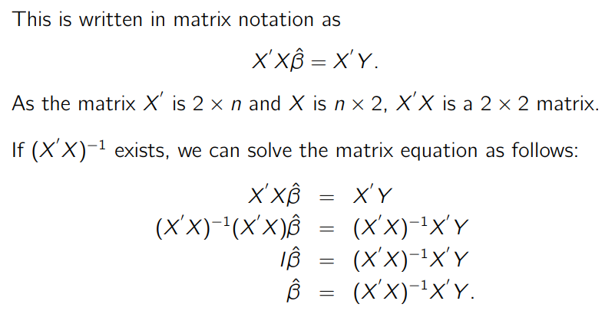

Solving the matrix equation

Slide 4
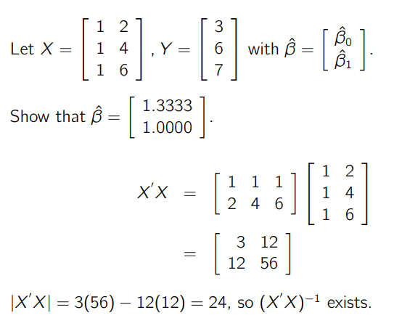
Example

Slide 5
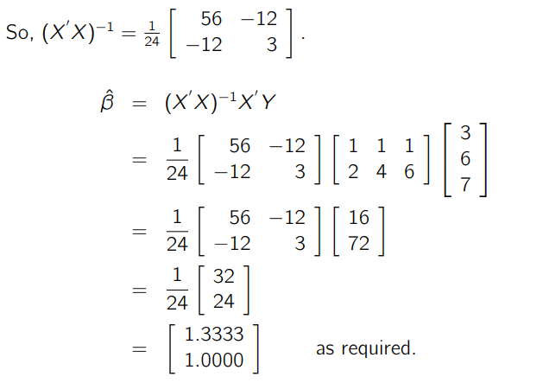
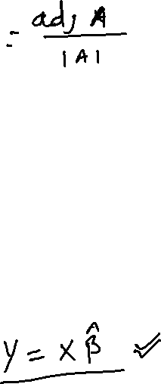

Slide 6
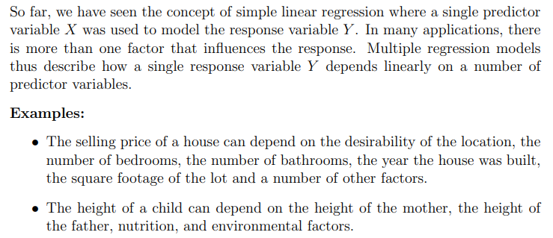
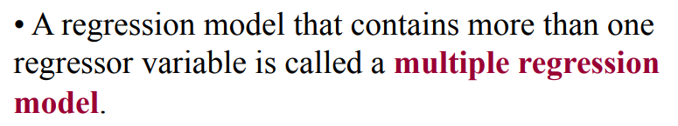
Multiple Regression and Correlation

Slide 7
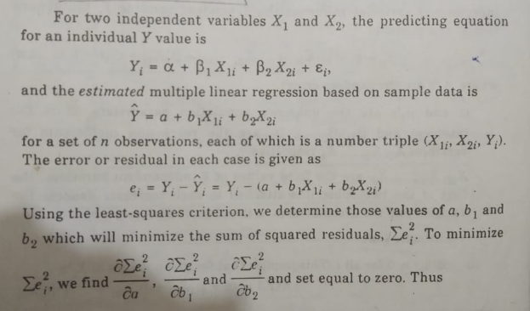
Multiple linear regression with two regressor

Slide 8
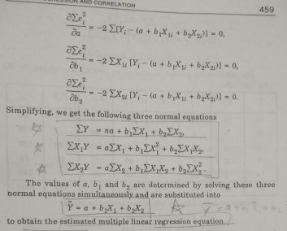

Slide 9
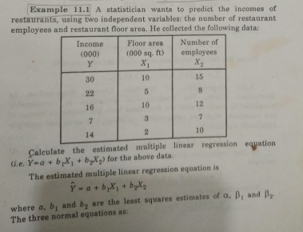

Slide 10
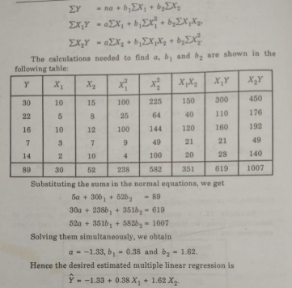
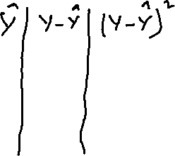

Slide 11


Slide 12


Slide 13


Slide 14


Slide 15


Slide 16


Slide 17


Slide 18


Slide 19


Slide 20
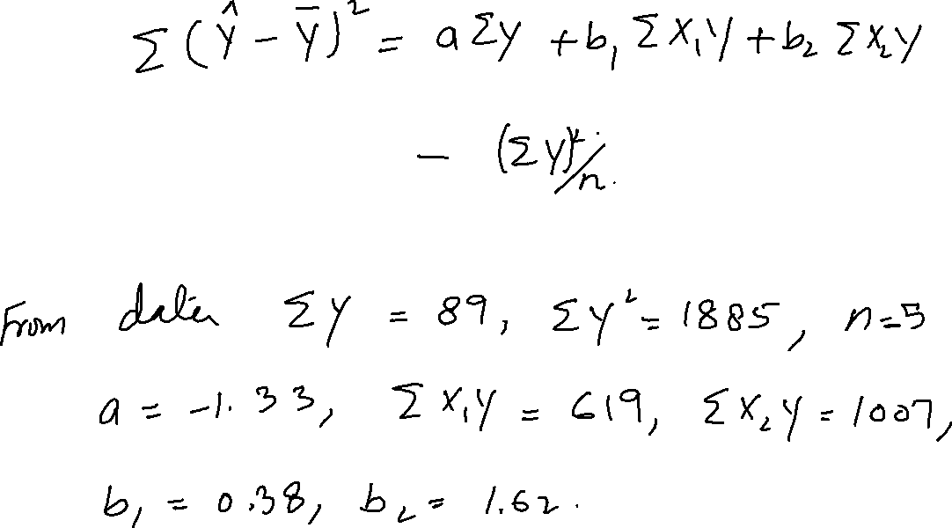

Slide 21
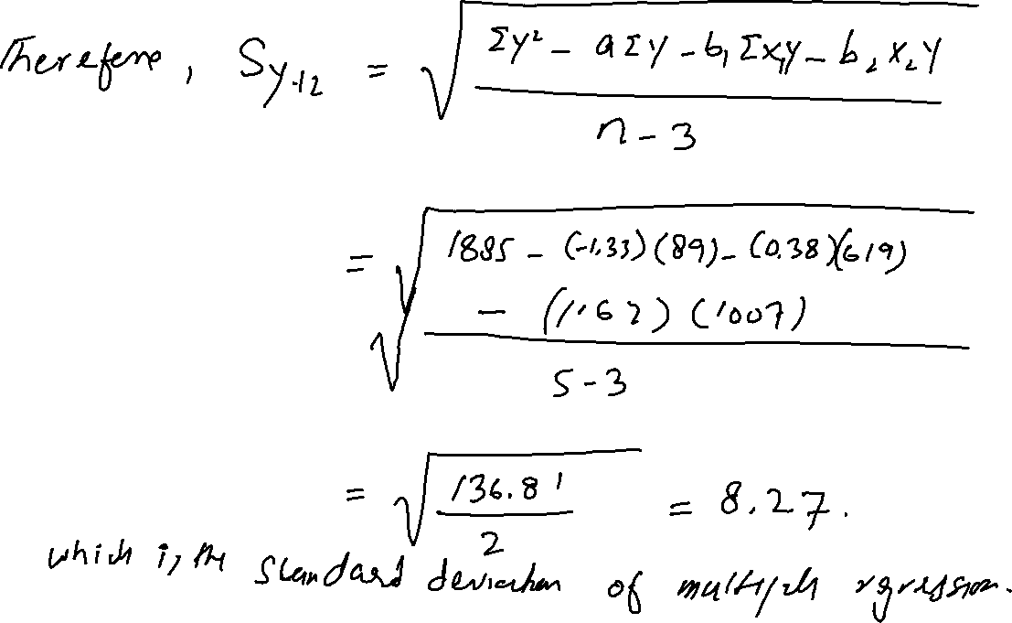

Slide 22
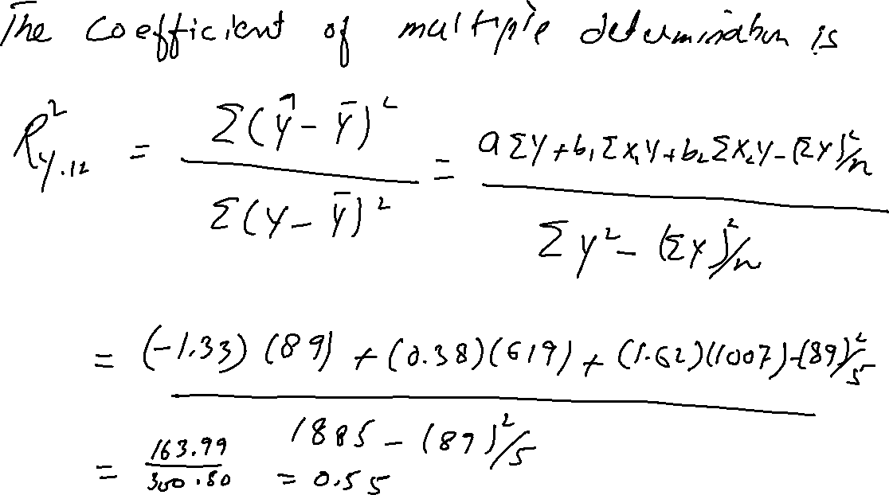

Slide 23
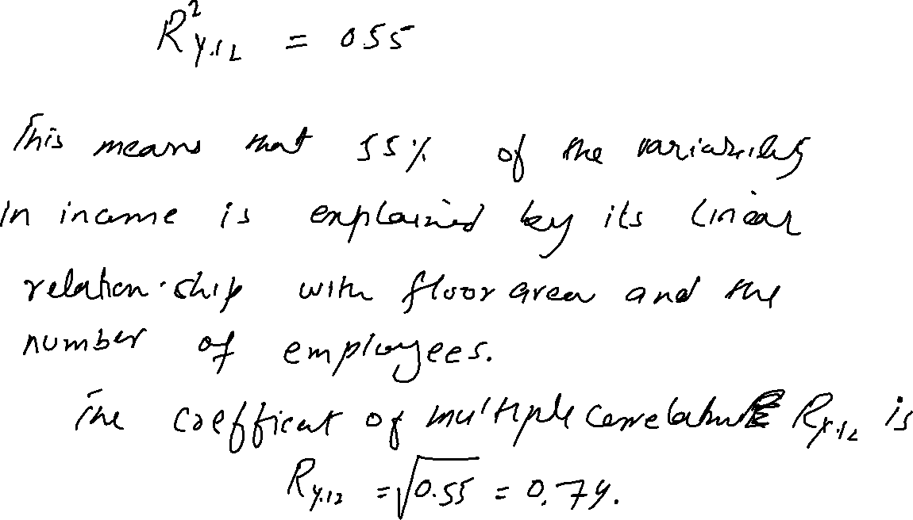

Slide 24
Nonlinear Regression Models
In statistics, nonlinear regression is a form of regression analysis in which observational data are modeled by a function which is a nonlinear combination of the model parameters and depends on one or more independent variables. The data are fitted by a method of successive approximations.

Slide 25
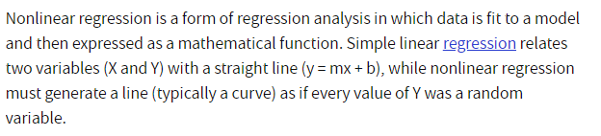
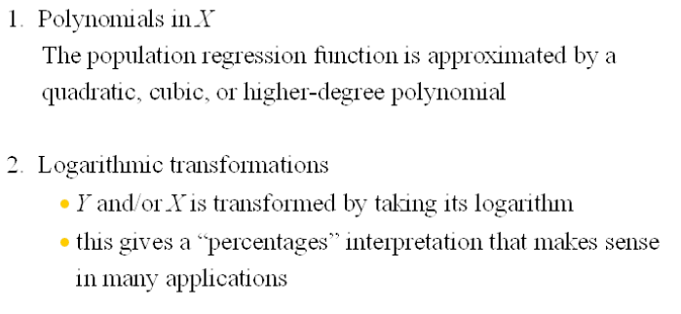

Slide 26
